Slide 1
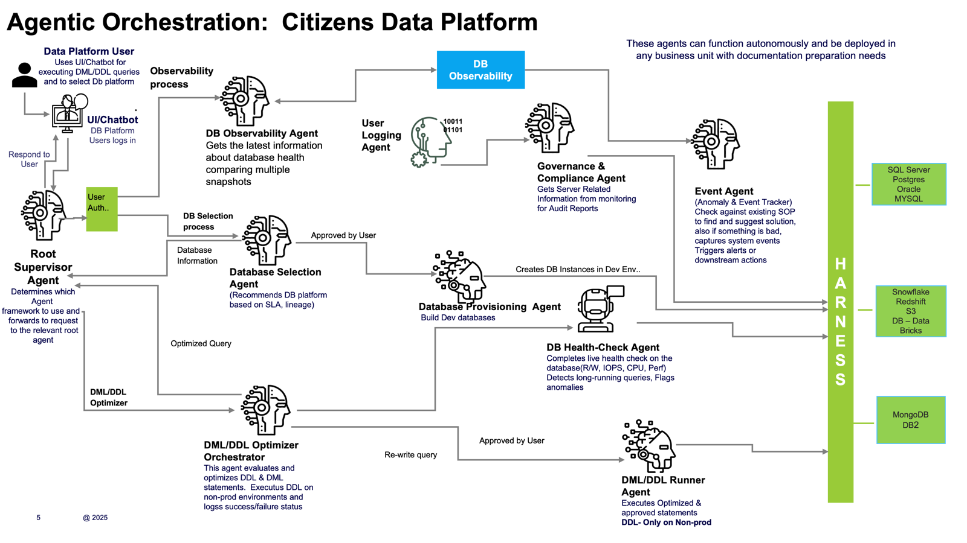

Slide 2
Agent / Actor | Role
User | Reports DB issue and provides context
Chat Interface | Collects structured inputs and communicates results
Root Agent | Orchestrates observability, compliance, approval, and resolution
DB Observability Agent | Pulls metrics/events, validates compliance, synthesizes diagnosis, monitors fix
Observability Platform | Supplies performance metrics and anomaly data
Event System | Provides correlated infra events(autonomous agent/service that executes itself when triggered by another agent)
Governance & Compliance Agent | Ensures observability scope meets audit/policy rules
DBA Team | Provides HITL approval, applies fix, confirms resolution
RE: Sequence diagram flow.
Prakash Hajela, Rajneesh (Cognizant)
​​
​​​
Hi Venkata,
Prepared sequence diagram for each steps,
Scenario 1 (DB Observability) → DBA approves mitigation path before fix is applied.
Scenario 2 (Database Selection) → DBA approves recommended DB before provisioning.
Scenario 3 (DML/DDL Observability) → DBA approves schema change before Runner Agent executes.
DB Observability:

Slide 3
Agent / Actor | Role
User | Requests schema change and provides DB type + intent
Chat Interface | Collects inputs and communicates results
Root Agent | Orchestrates observability, approval, and execution
DML/DDL Observability Agent | Validates compliance, checks infra events, monitors execution
Governance & Compliance Agent | Ensures schema changes comply with audit rules
Event System | Supplies infra events for risk avoidance
DBA Team (HITL) | Provides human approval before execution
DML/DDL Runner Agent | Executes approved DML/DDL operations

